Slide 1
Applied Machine Learning
Sunil Kumar​

Slide 2
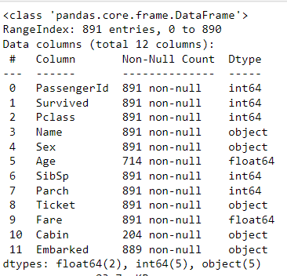
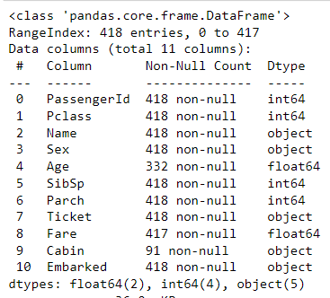
Titanic Classification Analysis
Data exploration
The Titanic dataset is split into two parts: the train set and the test set.
The train set consists of 891 rows, while the test set has 418 rows.
The train dataset contains 12 columns, whereas the test dataset lacks the target class variable "Survived."
The data includes a mixture of float, int, and object data types.
The descriptive statistics is attached in the Jupiter notebook

Slide 3
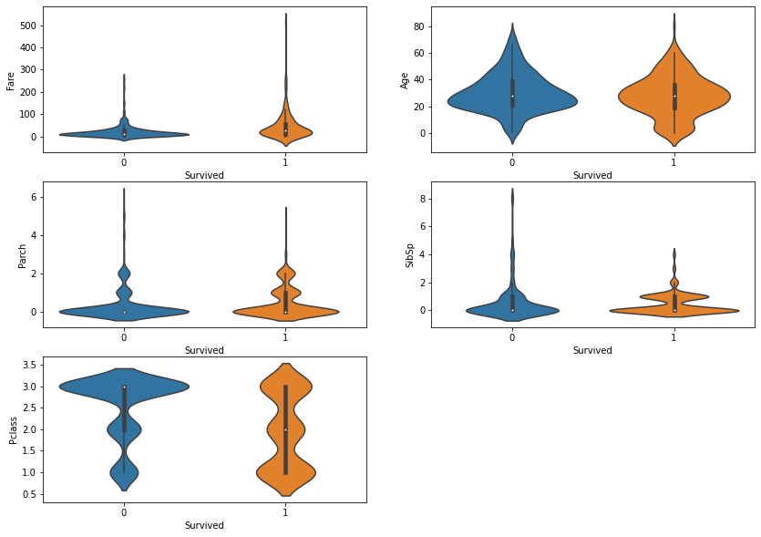
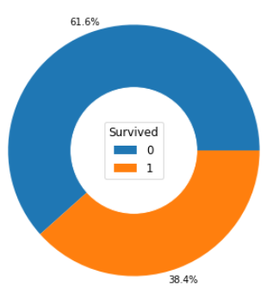
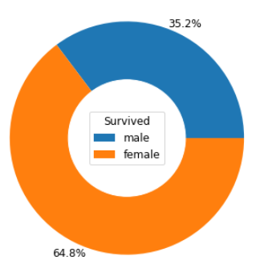
Data visualization
This analysis contain a variety of visualizations to explore frequencies, relationships, correlations, comparisons, and many more. A few examples are shown in this presentation.
There are 38.4% of passengers survived but 65% are females
Majority of survivors and not survivors are younger age band, but more survived are board on upper classes.
The fare distributions shows majorities travelled with lower fare bands.
Majority of travelers not survived in Pclass3, and many survived in Pclass1
Small group of Parch and SibSp survived

Slide 4
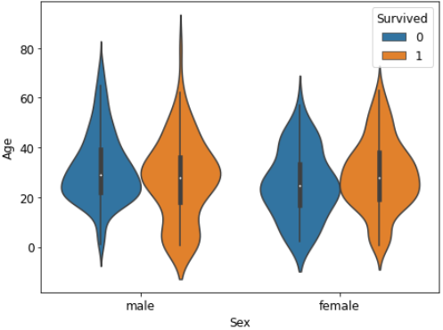
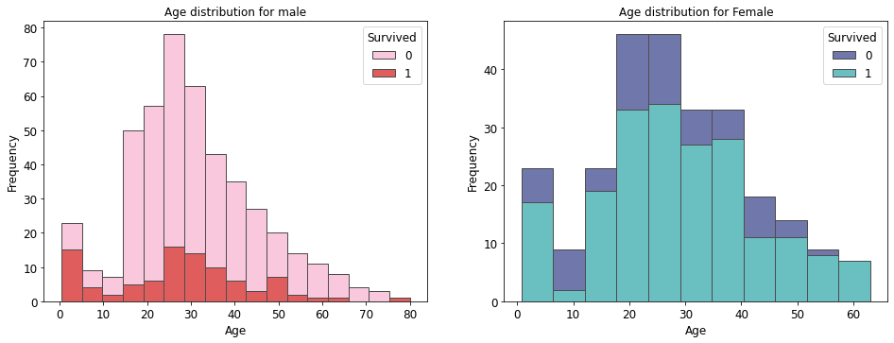
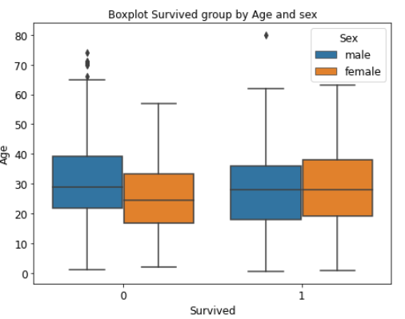
Survivors are among infants in both male and female groups
The average age of male and female survivors are about 28 and the male survivors are slightly younger than females
Majority of not survived males aged between 22-40 and females are 18-34

Slide 5
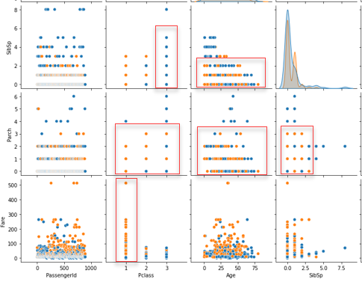
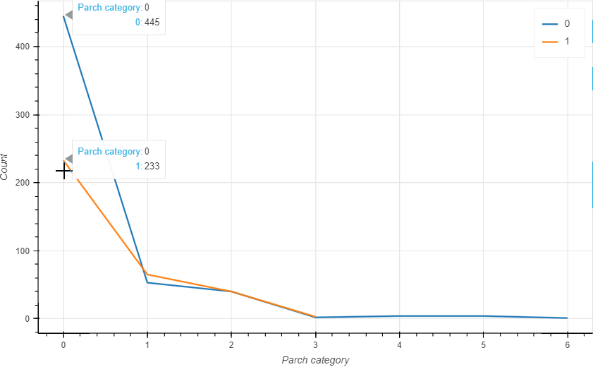
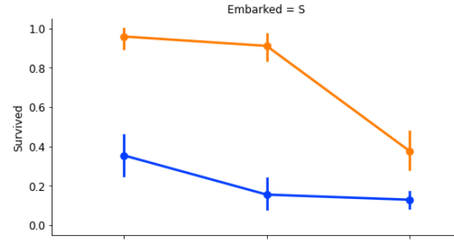
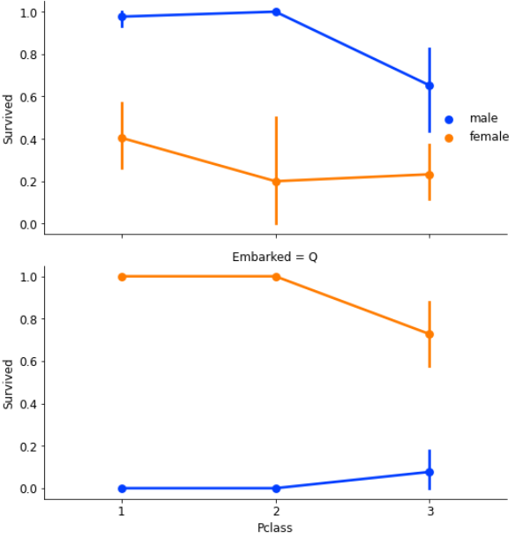
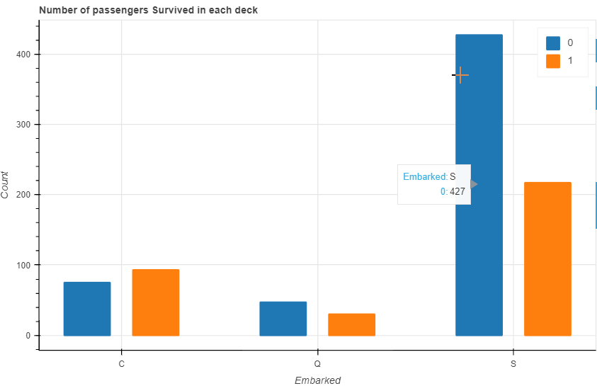
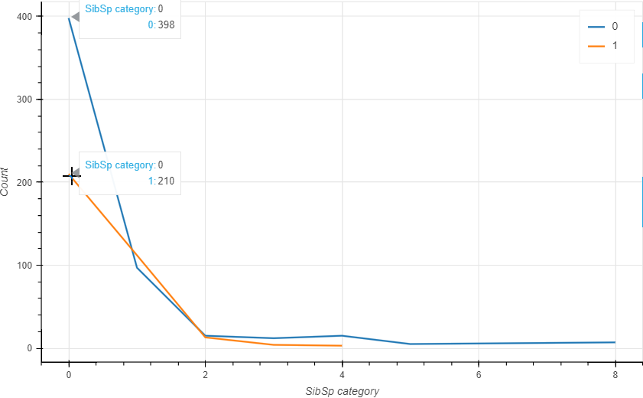
The parent, child and siblings, spouses travelled together
The larger the Parch and SibSp tend to be younger
The group is small better the survivor chance
Passenger embarked in S deck has higher survival chance in pclasses 1 and 2

Slide 6
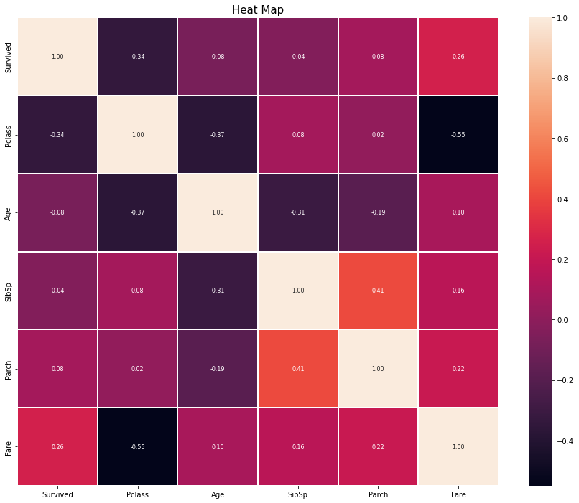
Correlations
The correlation heatmap provides a lot of insights of the data.
The class increase from 1-3, the fare decreased.
There is positive correlation Parch and SibSp indicates that larger group of family have a larger group of spouse and siblings travelled together.
As age increase the Pclass decreases. Younger passengers travelled in lower classes.
The number of siblings increases, the age tends to be lower
Survival chances decreases as Pclass increases

Slide 7
Pre-processing
Feature Engineering
Created new feature Ticket Frequency into 5 classes using ticket variable
Managing missing values
Filled Age values with mean in conjunction with standard deviation
Filled Fare value with median
One-hot Encoding
All class features like, 'Pclass', 'Sex', 'SibSp', 'Parch', 'Embarked', 'Ticket_Frequency', 'relatives', 'alone', 'Location', 'Title’ are encoded and drop the first
Standard Scaling
Map the cabin value frequencies to 8 classes A-G and U and created new feature ‘Location’, such as Location_A, Location_B, etc, finally
Age and Pclass combined and created new feature Age_Class by multiplication.
Creates a new feature called 'Fare_Per_Person’ from 'Fare’ and sum of the 'relatives’ feature
Replaced nan values in the Embarked feature with its mode
Filled location values wit mode
Used standard scaler and standardize the features to o mean of 0 and standard deviation of 1 to make all same units for model building.
Name feature is broken to 5 classes as per Title, Miss, Mr, Mrs, etc.
New feature from Parch and SibSp as ‘relatives’ and a value that shown someone is ‘alone’ or not

Slide 8
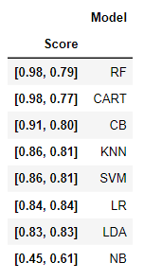
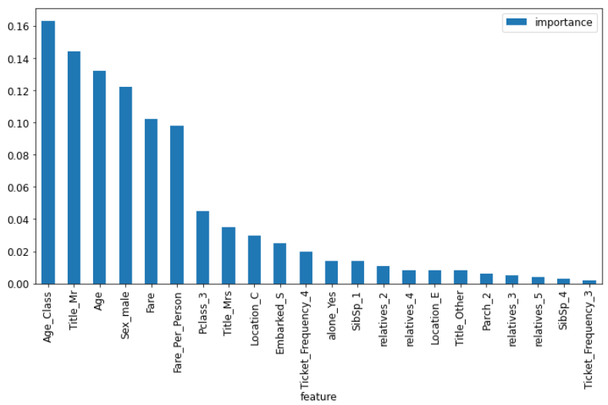
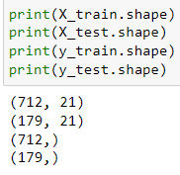
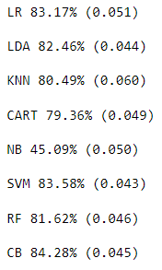
Model building
Feature Selection
Applied Lasso (alpha= 0.003) feature selection method to extract 21 significant features based on scores
Data partitioning
The training data split in to two groups as 80% for train and 20% for testing. No data allocated for cross-validation as it done in K-folds validation on training data
Training and K-Fold validation
Used 8 classification models in a loop for training and 10-fold cross validation for model selection
Model selection
Used the best train , test and cross validation combination score to choose model for further analysis
Random Forest

Slide 9
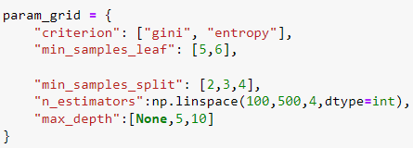
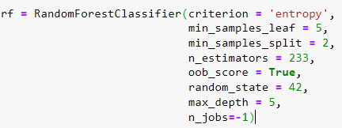


Hyper parameter tuning
GridSearchCV
Create parameter grid with 5 parameters and turned
Re-train Random Forest model
Applied the best parameter
10-Fold Cross-Validation
Used 10-fold cross validation to contain overfitting issue
Random Forest model is finalized with ‘oob’ score of 82.3%
Finalizing
Mitigated the overfitting issue by cross validation with mean of 82.74% and standard deviation of +/- 5.5%
Overfitting

Slide 10

Model Evaluation Matrix
Accuracy
Confusion Matrix
F-Score
Precision & Recall
In the first row of the confusion matrix, the Random Forest model correctly classified 394 passengers as not survived (true negatives) and incorrectly classified 45 passengers as not survived when they actually survived (false positives).
In the second row of the confusion matrix, the model misclassified 83 passengers as survived when they did not (false negatives) and correctly classified 190 passengers as survived (true positives)
The precision of the Random Forest model is 80.85%, indicating that it correctly predicts a passenger's survival in 80.85% of the case
The F-score combines precision and recall into a single metric, calculated using the harmonic mean of the two. It is worth noting that the F-score assigns more weight to lower values, emphasizing the importance of having both high precision and recall for a high F-score 80.85%
ROC AUC Curve
The ROC score is 93.91% . A perfect classifier that makes all correct predictions would have an ROC AUC Score of 1, while a completely random classifier would have a score of 0.5.
The classification accuracy is 78.72% is the ratio of the number of correct predictions to the total number of input samples
The recall metric reveals that the model predicted the survival of 69.6% of the passengers who actually survived.

Slide 11
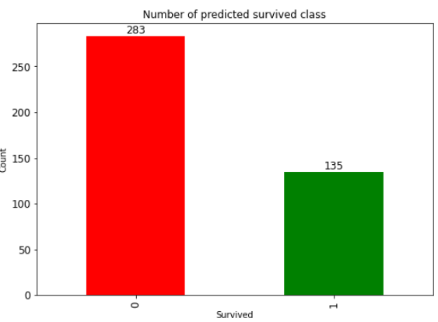
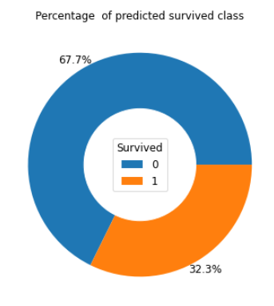
Predicted Survived Classes
Key Features
Age
Pclass
Sex
Fare
Title
Cabin
Embarked
Parch
SibSp
Bias and Variances
The misclassified true negatives remains around 45, but some variation in the true positives, by approximately 5.
Examining the confusion matrix at different runs, small variations are noticed. It can be attributed to variances, indicating that the model's performance fluctuates slightly.
Assessing the bias and variance, it can be observed that the model exhibits low bias and slight variations between training and test data. This indicates a tradeoff between bias and variance

Slide 12
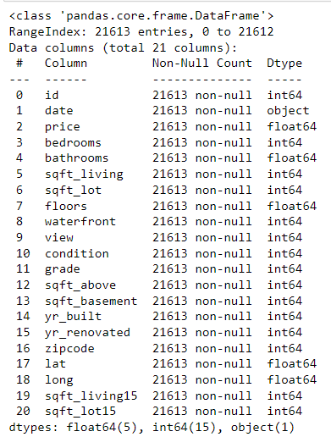
KC House Price Regression Analysis
Data exploration
The Titanic dataset is split into two parts: the train set and the test set.
The KC House dataset consists of 21613 rows with 21 columns.
The target variable “Price."
The data includes a mixture of float, int, and object data types.
There is no missing data in the dataset.
It contains 177 rows of duplicate data
The descriptive statistics is attached in the Jupiter notebook

Slide 13
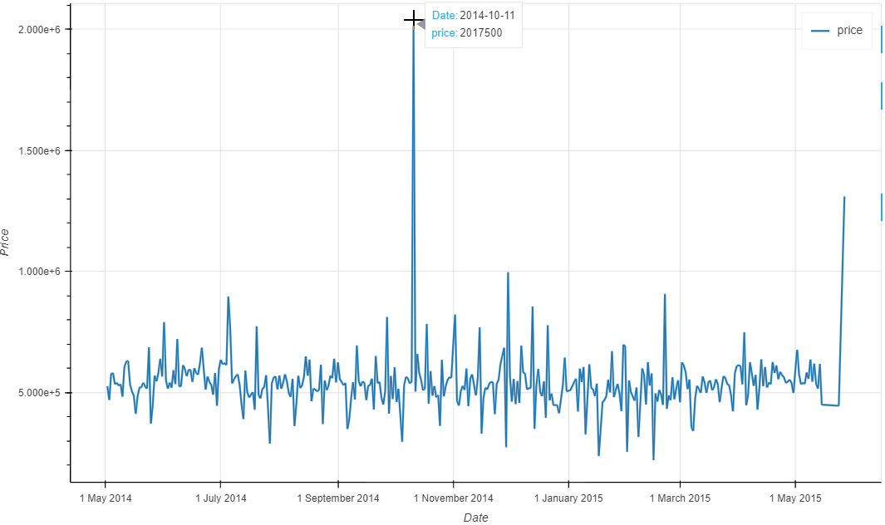
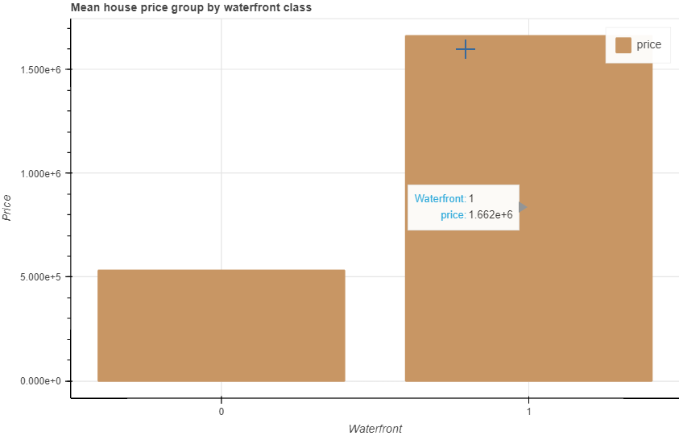
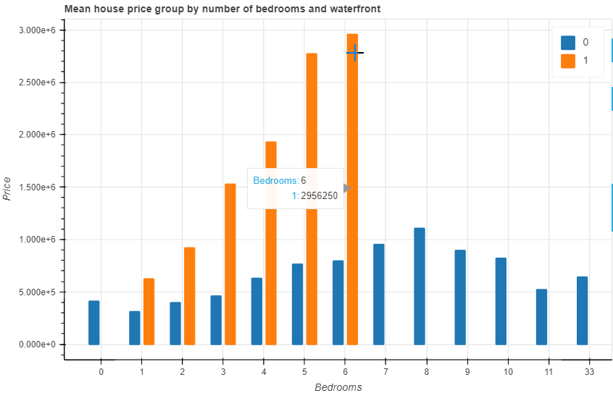
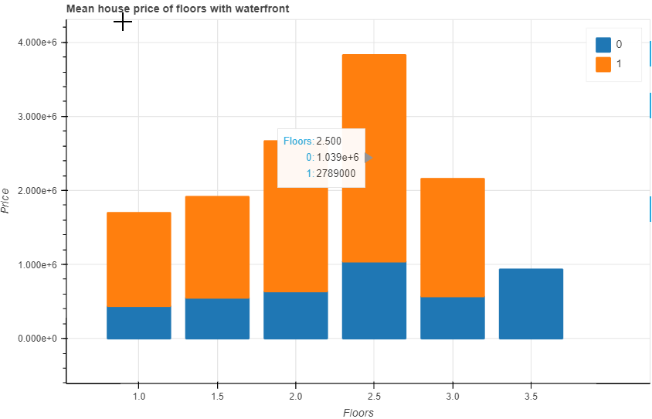
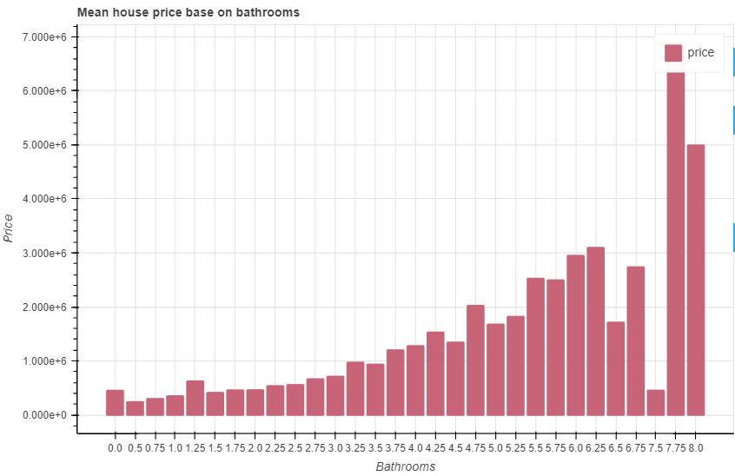
Data visualization
This analysis contain a variety of visualizations to explore frequencies, relationships, correlations, comparisons, and many more. A few examples are shown in this presentation.
The highest house sale was in year Sep 2014
The waterfront flats were sold at higher price in general and its consistent with other attributes
The number of bathrooms increases price but a its declined at a saturation point at 6.5
Piece of number of floors is higher for waterfront houses as number of floors increases up to 3. The highest price was for 2.5 story house for both waterfront or not
The highest price of houses with 6 bedrooms located at waterfront whereas 8 bedrooms for other locations

Slide 14
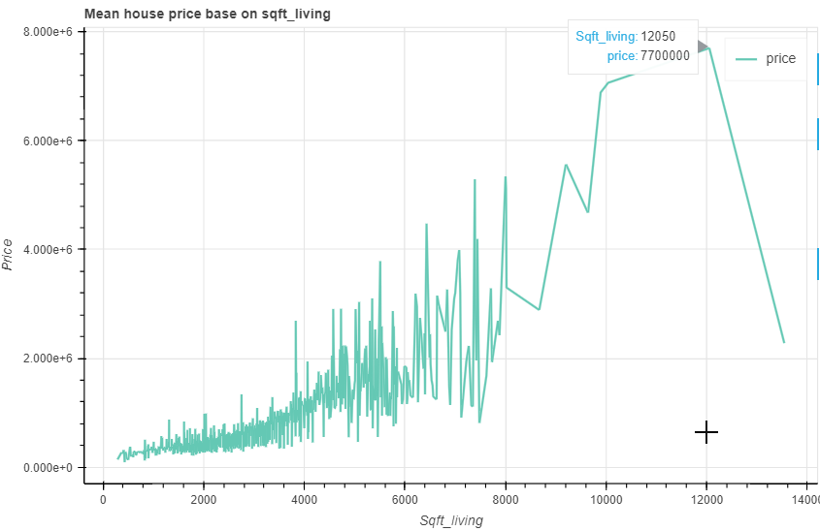
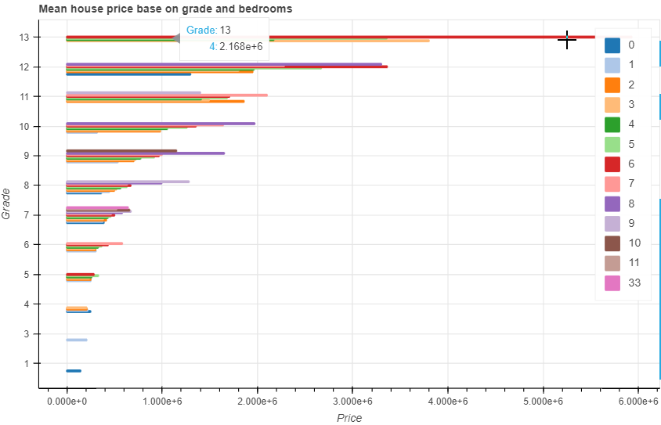
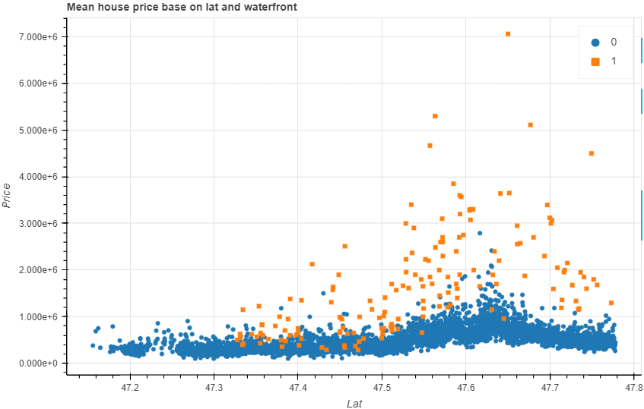
Data visualization
The square feet living increases the price increase up to 12,0000sqft and decline.
Higher latitude waterfront locations are expensive as compared to other locations
The combination of higher-grade with 6 number of bathrooms yields the highest sales price.

Slide 15
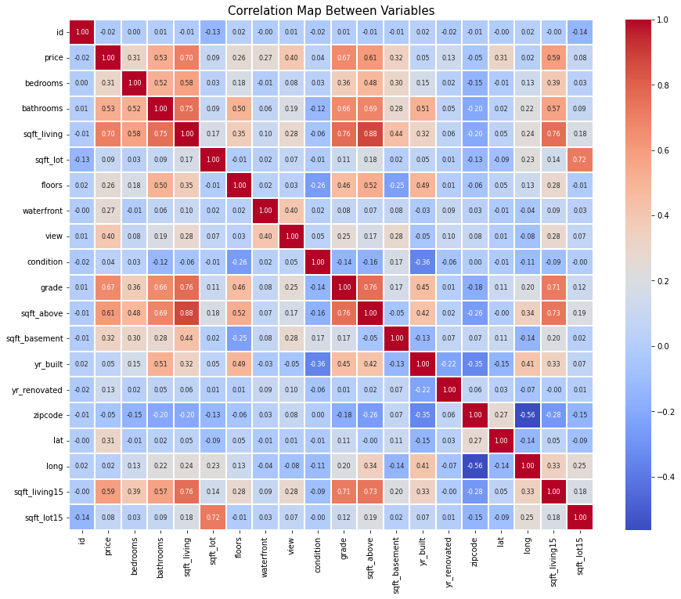
Correlations
The correlation heatmap provides a lot of insights of the data. Discussing the correlations +/- 0.5 and above
Sqft_lot15 exhibits a strong positive correlation with sqft_lot, When the size of the lot (sqft_lot) increases, the size of the lot for the nearest 15 neighbors (sqft_lot15) also tends to increase.
Sqft_living15 have moderate to strong positive correlations with bathrooms, sqft_living, grade, and sqft_above.
As the living area (sqft_living15) increases, number of bathrooms, total living area, grade of the property, and the above-ground living area to increase as well.
Yr_built displays a moderate positive correlation with bathrooms, houses builds recently have a greater number of bathrooms
Sqft_above exhibits moderate positive correlations with bathrooms, sqft_living, and floors. This suggests that number of bathrooms, total living area, and number of floors to increase as well.
Grade demonstrates strong positive correlations with bathrooms and sqft_living, indicating that as the grade of the property increases, the number of bathrooms and total living area to increase as well.
There are moderate correlations between bathrooms and bedrooms, as the number of bathrooms increases, the number of bedrooms to also increase.

Slide 16
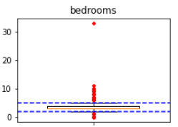
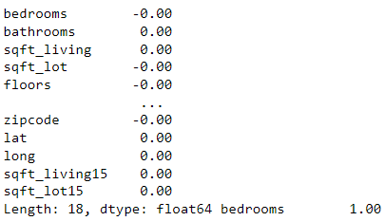
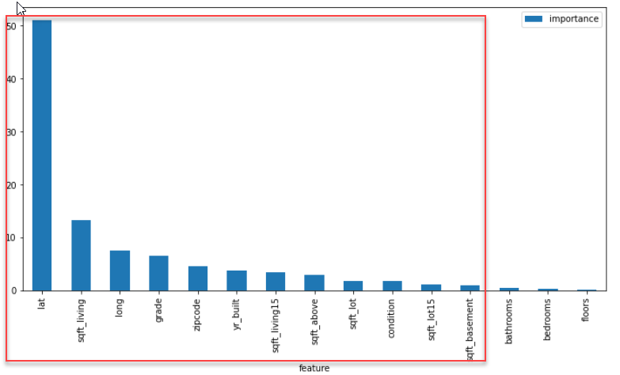
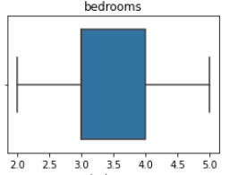
Pre-processing
Managing Outliers
Potential outliers removed based on Q1-1.5 IQR and Q3+1.5 IQR
Standard Scaling
Standardizes the data with mean 0 and standard deviation of 1.
Feature selection
Applied cat boost regressor to choose top 12 features

Slide 17
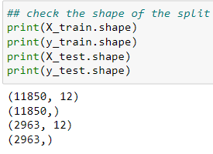
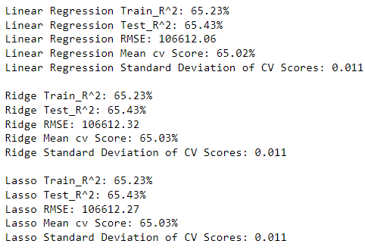
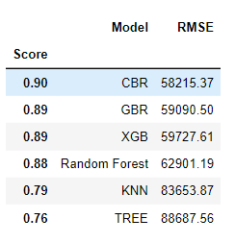
Model building
Data partitioning
The data split in to two groups as 80% for train and 20% for testing. No data allocated for cross-validation as it done in K-folds validation on training data
Training and K-Fold validation
Linear regression, Ridge, Lasso in a loop and other 6 models used for training and 10-fold cross validation for model selection
Model selection
Used the best train , test and cross validation combination score and RMSE to choose model for further analysis
CatBoost Regressior
Models underfitting

Slide 18
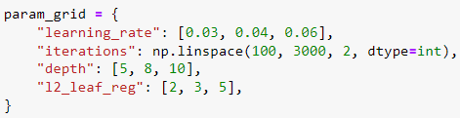
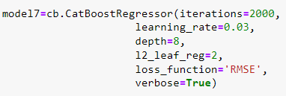

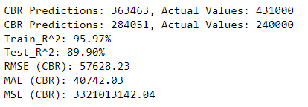
Hyper parameter tuning
GridSearchCV
Create parameter grid with 4 parameters and turned
Re-train Random Forest model
Applied the best parameter
10-Fold Cross-Validation
Used 10-fold cross validation to contain overfitting issue
CatBoost Regressor model is finalized with test score of 89.9%
Finalizing
Cross-validation undermines the overfitting issue with a mean of 88.79% with standard deviation of +/-1%
Overfitting

Slide 19
Model Evaluation Matrix
Mean Absolute Error (MAE)
Mean Square Error (MSE)
R-Squared value
Root Mean Square Error (RMSE)
This measures the squared average distance between the real data and the predicted data which is 3321013142.04. The aim is to reduce the mean square error
The RMSE score, which measures the average difference between the actual and predicted prices, is 57628.23.
The predicted price may deviate from the actual price by $57,628.23
The proportion of the variance of dependent variables that is explained by independent variables (X=12) in the regression model which is 89.9%
MAE score, which represents the average absolute difference between the actual and predicted prices, is 40742.03
The predicted price may deviate from the actual price by $40’742.03

Slide 20
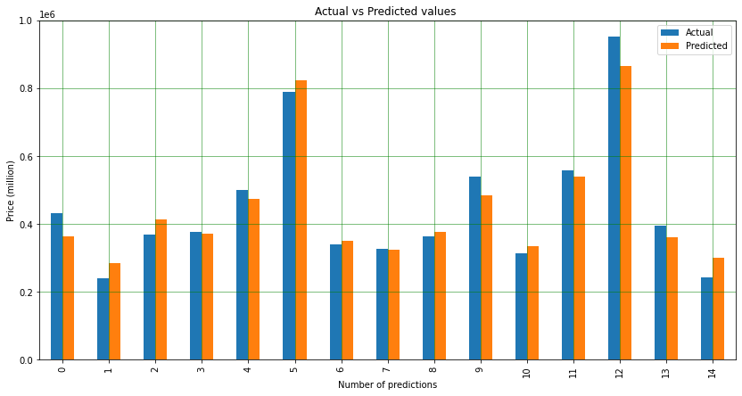
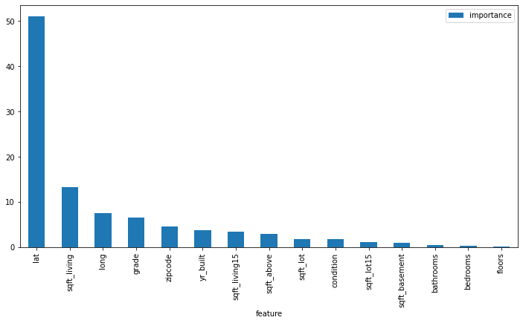
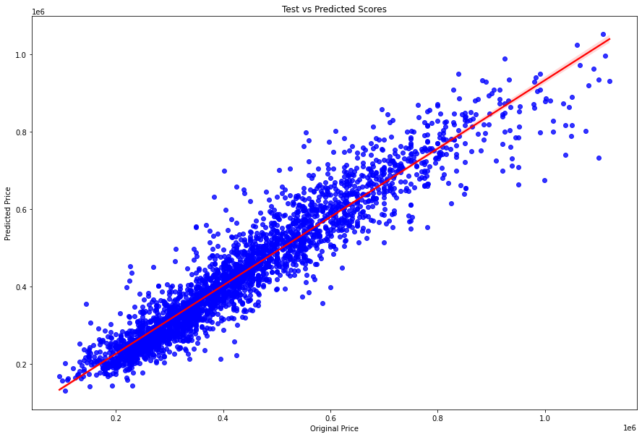
Actual vs Prediction
Key Features (12)
Scatter:
Actual vs Predicted

Slide 21
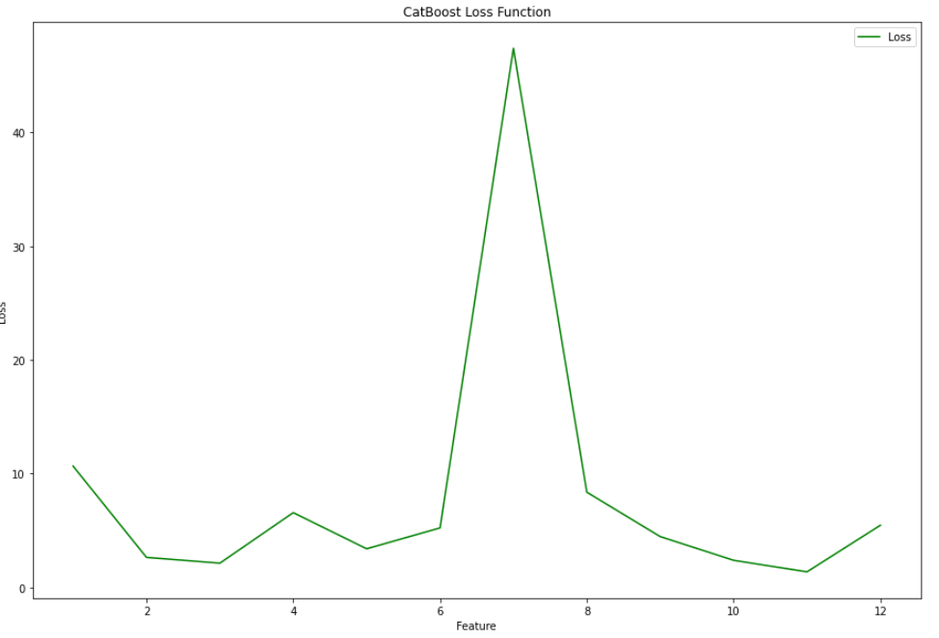
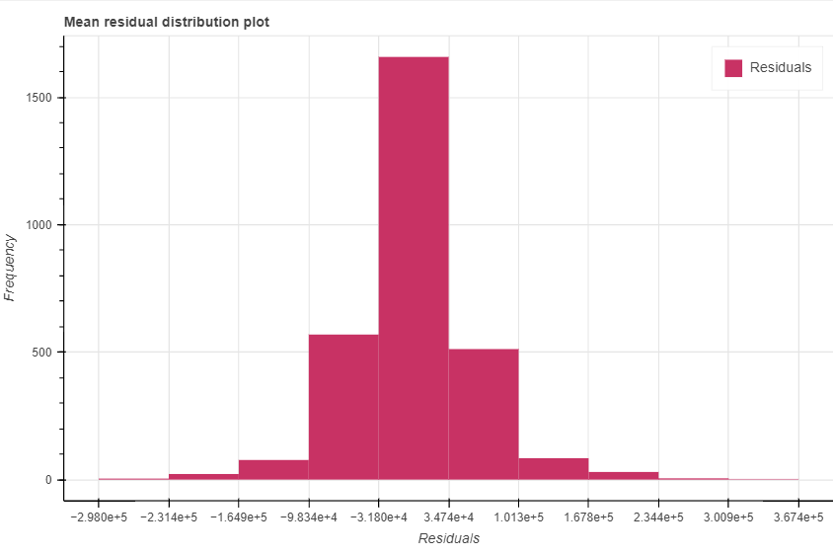
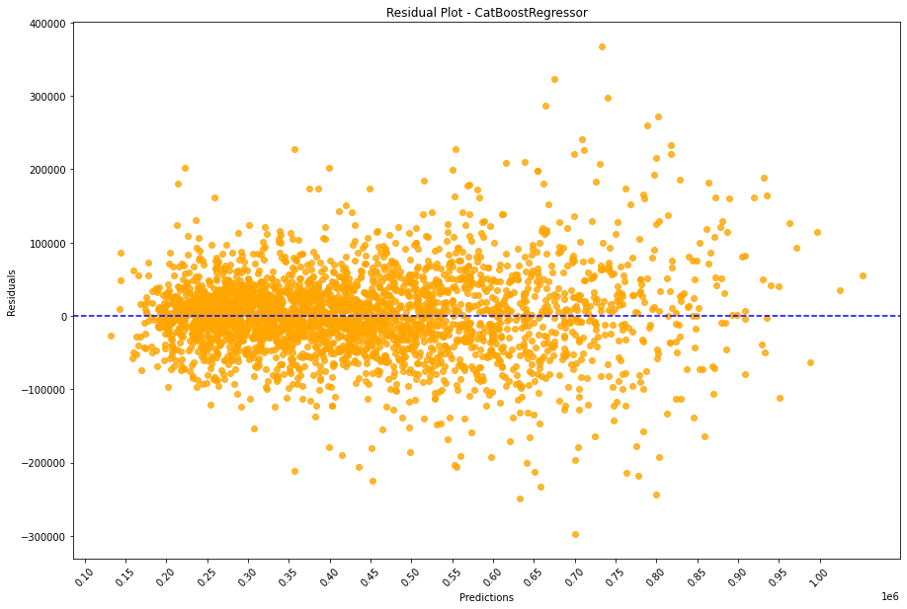
Residual distribution
Loss function: Latitude is highly sensitive to the house price
Residual plot

Slide 22
Thank you
Sunil Kumar

